Slide 1
DMR Repeater Tune and Test
DR600
TR850

Slide 2
Content
1
Test Equipment
2
PC software Installation
3
Tune Parameter
4
Parameter Test

Slide 3
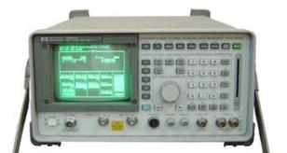
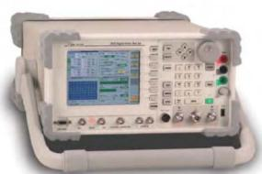
1
Test Equipment
Test Cable
1、Test connecting cable
2、RF connecting cable
3、False battery
Test Equipment
1、DC/AC Power supply
2、HP8921A
3、IFR3920
4、pc
5、Multimeter
Analog Analyzer HP8921A
Manufacturer: HP
Digital Analyzer IFR3920 with DMR option
Manufacturer: Aeroflex

Slide 4
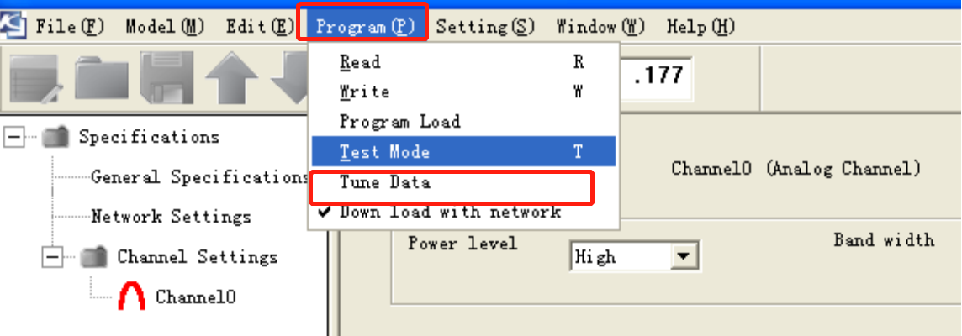
2
PC Software Installation
1、Install pc software
Please open the pc installation and install it according to instruction
2. Set test password
1) Add a new txt file in the installation directory and name it to “adjustmode”. Then run the programming software again.
2) The tune mode will be shown under the menu of program. Note: It is only allow to enter to turn mode when repeater connected to PC well.

Slide 5
3
Tune Parameter
Program test frequency
 | TR850-01\DR600-01【136~174MHz】 |  | TR850-02\DR600-02【400~470MHz】
Ch | TX(MHz) | RX(MHz) | TX(MHz) | RX(MHz)
Ch1 | 136.0250 | 136.2250 | 400.0250 | 400.2250
Ch2 | 144.0250 | 144.2250 | 418.0250 | 418.2250
Ch3 | 154.9875 | 154.9875 | 434.9875 | 434.9875
Ch4 | 155.0250 | 155.2250 | 435.0250 | 435.0250
Ch5 | 163.0250 | 163.2250 | 453.0250 | 453.0250
Ch6 | 174.9875 | 174.9875 | 469.9875 | 469.9875

Slide 6
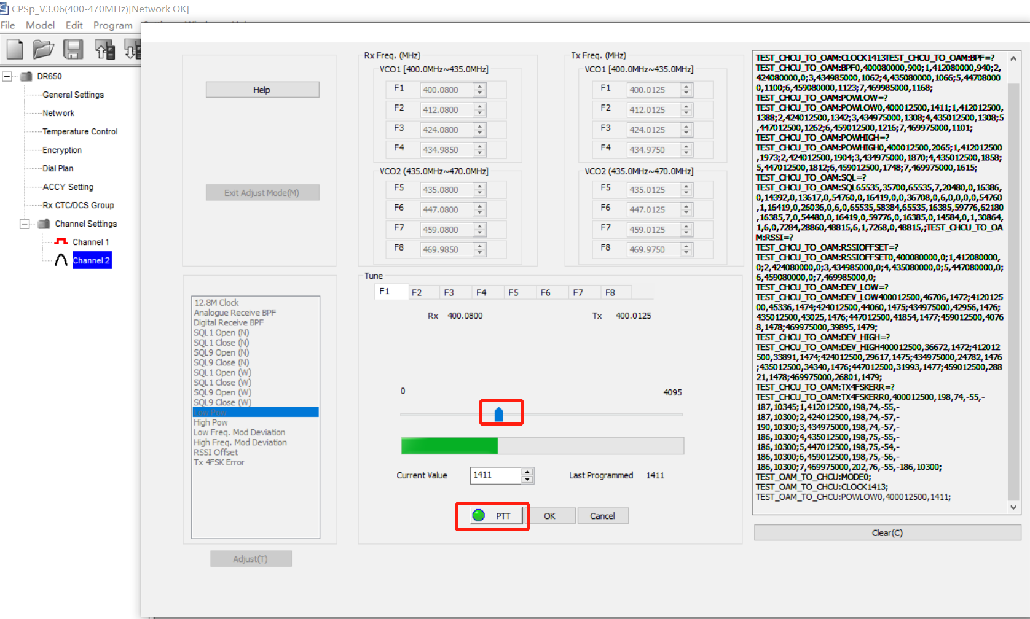
4
Tune Parameter
Tune Low and High power
Set the HP8921 to tx mode.
Enter to pc tune mode
Double click “high pow” to adjust high power . Please adjust each frequency.
After adjust, please click “OK” to save it.
Refer to the above steps to tune low power.
Move it to adjust power value
Click PTT to enter tx
Suggested Power value for high and low :
High Power | VHF | 45.0W±2W
 | UHF | 40W±2W
Low Power | 20W±0.2W

Slide 7
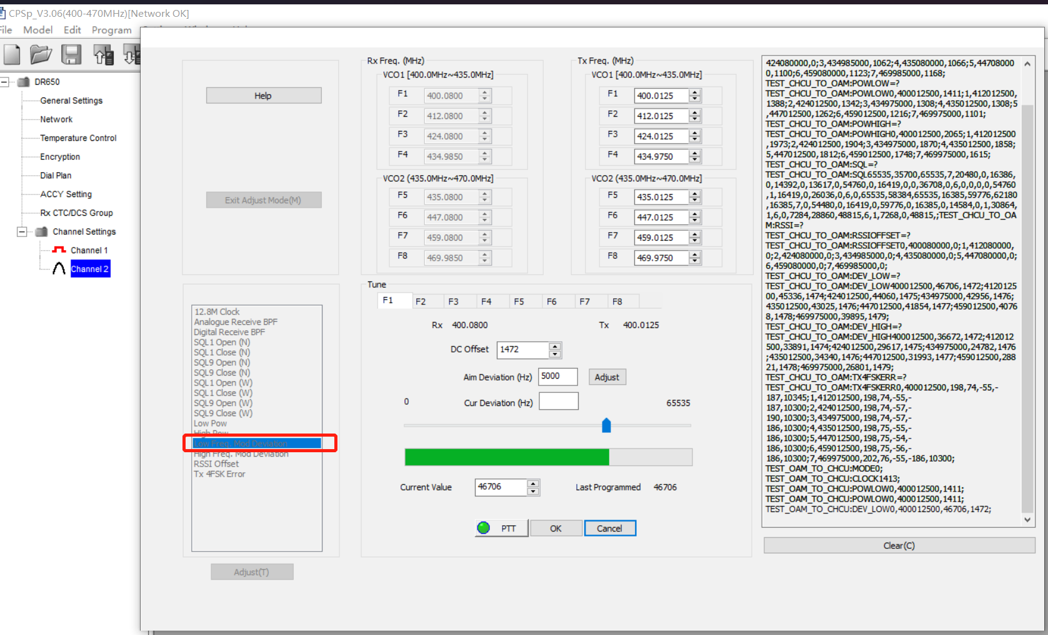
3
Tune Parameter
Frequency Stability
Set the mode to “TX mode” on the HP8921
Enter to PC tune mode
Double click “Low Freq.Mod Deviation”
Adjust the value on PC until the TX freq error is within “±40Hz” on the HP8921
Then Click “OK” to save it.
Please use the same method to adjust high frequency .Mod Deviation
Frequency Stability | ±40Hz

Slide 8
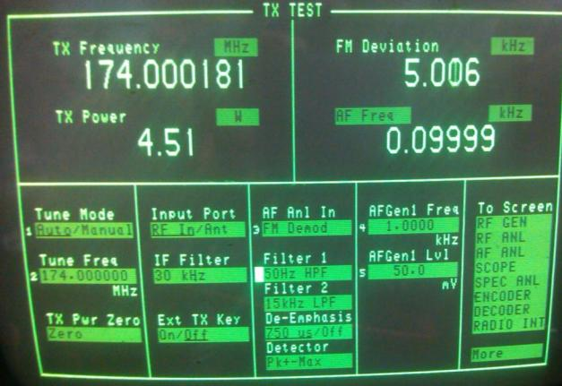
3
Parameter Tune
Low frequency modulation deviation
High frequency modulation deviation
Set HP8921 to tx test mode
Enter to PC tune mode
3.Double Click “LF modulation deviation” and click F1 to F6 to adjust the pc data to adjust the deviation to 5.0±0.05kHz
4.Click ok to save it
Low Frequency modulation deviation | 5.0±0.05kHz
High Frequency modulation deviation | 5.0±0.05kHz
Filter 1:50Hz HPF
Filter 2: 15KHz LPF

Slide 9
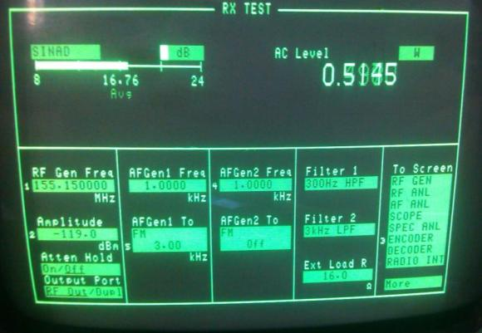
3
Parameter Tune
Set the HP8921 to RX TEST mode
Enter to pc tune mode
3.Double click “RF rx sensitity” and enter to F1 to F6 to adjust its sensitivity
4.Set amplitude to -119dBm, and set the RF frequency to F1 to F6 ,then adjust pc data to keep the SINAD to maximum and above 12dB
RF RX sensitivity
RF Gen Freq: rx frequency of radio
RX sensitivity | SINAD>=12dB
Amplitude:-119dBm
Set to 16
Filter 1:300Hz HPF
Filter 2: 3KHz LPF
Set to 3KHz

Slide 10
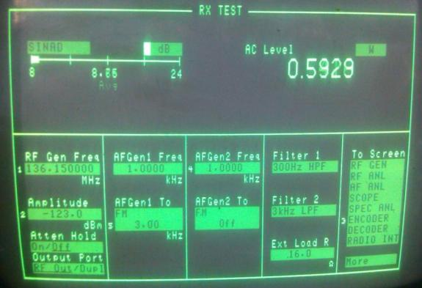
3
Parameter Tune
SQL1 Open and Close
Set the HP8921 to RX test mode
Enter to PC tune mode
3.Double Click “SQL1 Open” and enter to F1 to F6 in sequence, then click “Start”. When the data on pc is stable, click stop.
4.Then click “:OK “ to save it.
RF Gen Freq:RX frequency of radio
SQL | Open | -123dBm
 | Close | -125dBm
Adjust this value according to SQL open and close lever
Wide band:3kHz
Narrow band:1.5kHz

Slide 11
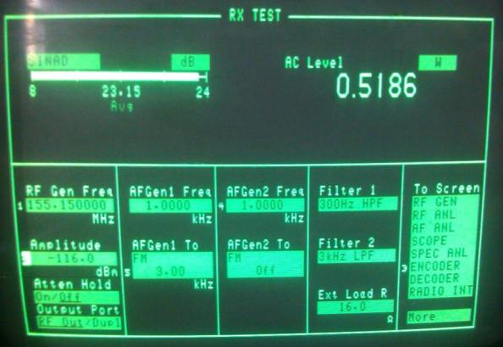
3
Parameter Tune
SQL9 Open, SQL9 Close
Set the HP to RX test
Enter to pc tune mode
Double click “SQL9 Open” and enter to F1 to F6 in sequence.
4. Click “Start”, when the data is stable, click “stop’.
5. After adjust all the freuqnecy, click “ok” to save the data
6. Use the same way to adjust the SQL9 Close.
RF Gen Freq:RX frequency of radio
Adjust this value according to SQL open and close lever
SQL9 | Open | -116dBm
 | Close | -119dBm
Wide band:3kHz
Narrow band:1.5kHz

Slide 12
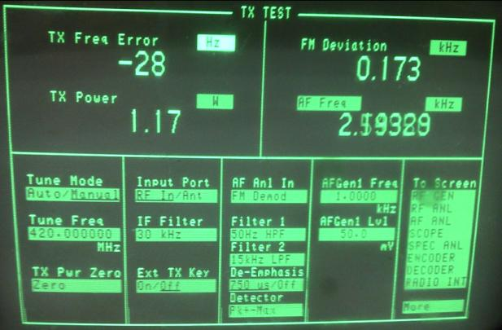
4
Test the parameter
Test frequency stability
Set the HP8921 to tx test.
Press ptt to transmit
View the TX Freq Error
Frequency stability | ±100Hz
Tune Mode: Manual
Set the tx frequency of your radio

Slide 13
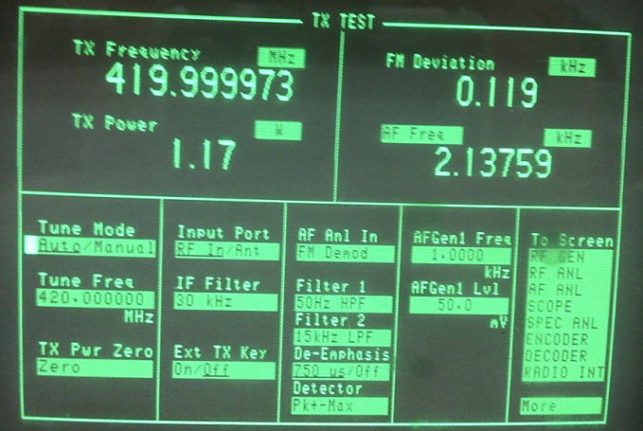
4
Test the parameter
Test High/Low Power
Set the HP8921 to Tx test
Press PTT to transmit
View the tx power value on HP8921,and view the current value on DC power supply.
Use the same way to test the low , mid and high frequency.
High Power | VHF | 5.0W±0.1W
 | UHF | 4.2W±0.1W
Low | 1.0W±0.2W
Tune Mode : Auto
Input Port: RF In
Current(H) | <1.8A
Current(L) | <1A

Slide 14
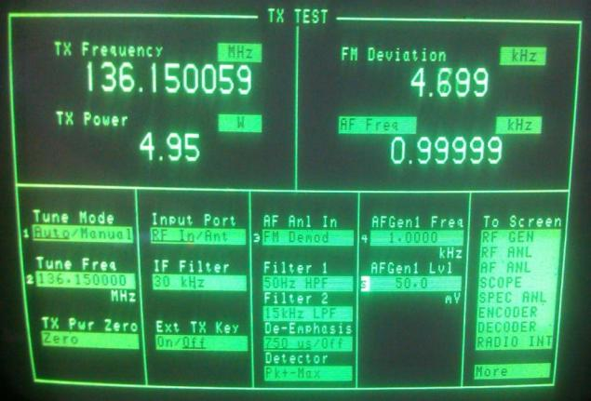
4
Test the parameter
Test the max deviation
Set HP8921 to tx test
Press PTT to transmit
View the FM deviation on the HP8921.
Use the same way to test the Low, mid and high frequency.
25KHz | 3.8kHz~4.8KHz;
12.5KHz | 1.8kHz~2.5kHz。
Modulation Sensitivity:50mV
AFGenl Freq:1KHz
Tune Mode : Auto
Filter 1:50Hz HPF
Filter 2: 15KHz LPF

Slide 15
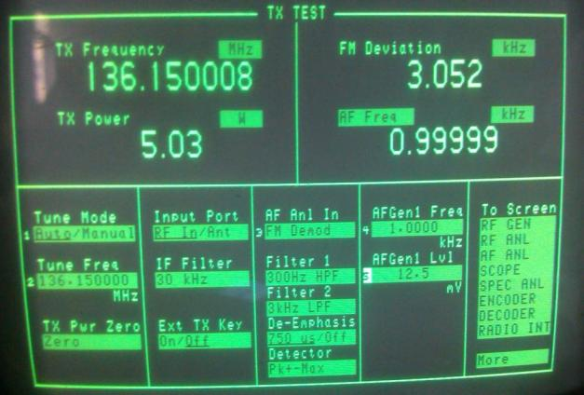
4
Test the parameter
Test the wide band modulation sensitivity
Set HP8921 to tx test mode.
Switch the channel to wide band. (25k), then press PTT to transmit.
Adjust the value of AF Gen Lv1 to let the FM deviation equal to 3k. The value of AF Gen1 LV1 is the modulation sensitivity
Filter 1:300Hz HPF
Filter 2: 3KHz LPF
Modulation Sensitivity | 12mV±5mV
AFGenl Freq:1KHz

Slide 16
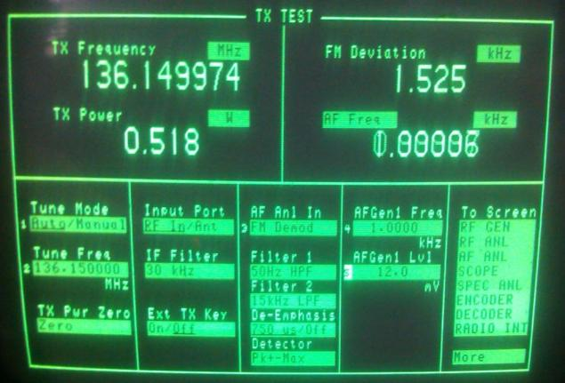
4
Test the parameter
Narrow band modulation sensitivity
Set the HP to Tx test
Switch the channel to Narrow band(12.5K),then press PTT to transmit
Adjust the value of AF Gen1 Lv1 and let the FM Deviation to 1.5K. The value of “AF Gen1 Lv1”is the modulation sensitivity.
Modulation Sensitivity | 12mV±5mV
AFGenl Freq:1KHz
Filter 1:300Hz HPF
Filter 2: 3KHz LPF

Slide 17
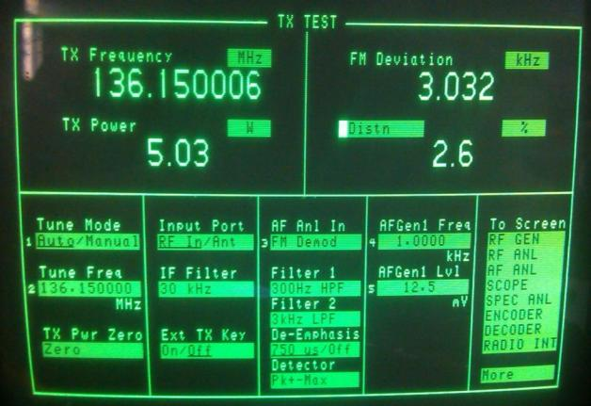
4
Test the parameter
Test Tx distortion
Set the HP8921 to TX mode
Set the filter from 300Hz to 3Khz. Set the AFGen1 Freq to 1K.
Press the PTT to transmit. Adjust the value of Gen1 Lv1 to let the FM Deviation to 3K.
Now set the Distn ,refer to picture. Please check the value of Distn. The distorting should be less than 3%.
5. Use the same way to test all the Low, high and middle frequency.
Modulation
Sensitivity
AFGenl Freq:1KHz
Filter 1:300Hz HPF
Filter 2: 3KHz LPF
Tx Distortion | ＜3%

Slide 18
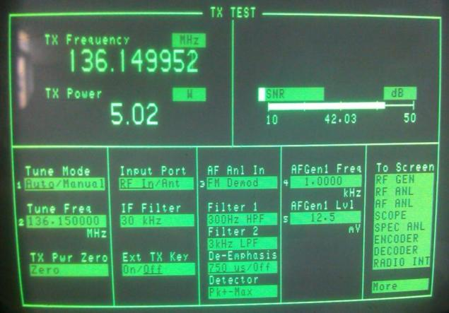
4
Test the parameter
Tx S/N
Set the HP8921 to TX mode. Filter :300Hz-3KHz.
AF Gen1 Freq:1KHz
AF Gen1 Lv1: modulation sensitivity.
Set the mode: SNR
2. Press PTT to transmit and view the value of SNR.
3. Use the same way to test Low, middle and high frequency.
Filter 1:300Hz HPF
Filter 2: 3KHz LPF
Modulation Sensitivity
AFGenl Freq:1KHz
SNR(Wide) | ＞45dB
SNR(Narrow) | ＞35dB。

Slide 19
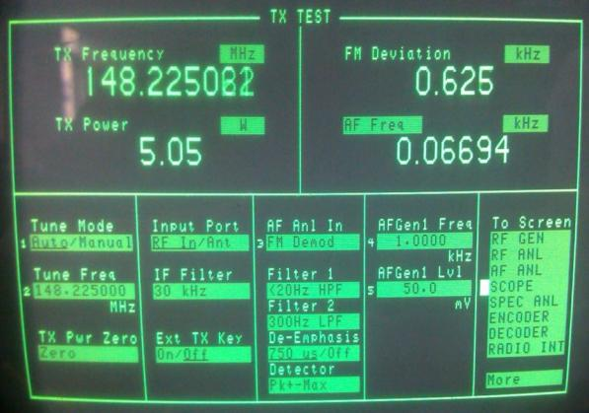
4
Test the parameter
Test the deviation of QT、DQT
HP8921: TX mode
Filter:<20Hz HPF, 300Hz LPF。
2. Press PTT to transmit
3. And view the value of FM deviation.
Deviation (Wide) | 0.5~0.9kHz
Deviation (Narrow) | 0.25~0.5kHz
Filter 1: <20Hz HPF
Filter 2:300Hz LPF

Slide 20
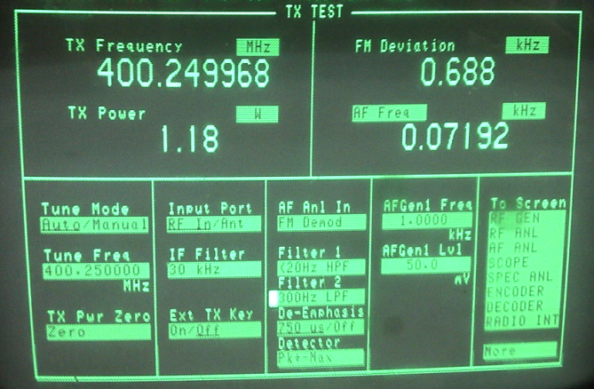
4
Test the parameter
Test VOX-1
HP8921:TX
AF Gen1 Lv1”:50mV。
2. Switch to the VOX channel. The radio will transmit automatically.
3. When turn of the signal of AF Gen1 Lv1, the radio will stop transmit.
VOX 1 | 50mV

Slide 21
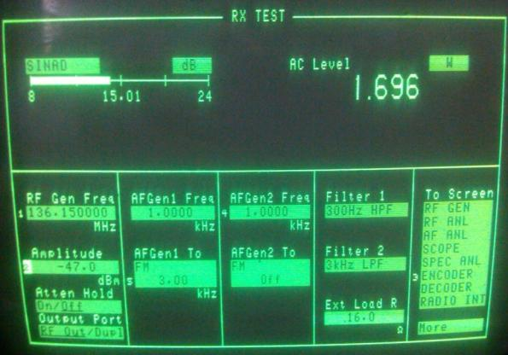
4
Test the parameter
Test the max audio output
HP8921： Rx Test.
Rotate the volume to maximum.
View the AC Level on HP8921 and view the current on power supply.
Use the same way to test wide band and narrow band.
RF Gen Freq: RX frequency of radio
Max Audio output | 1.4W ±0.2W
Current | ＜0.5A
Wide band:3kHz
Narrow band:1.5kHz
Set to 16
Filter 1:300Hz HPF
Filter 2: 3KHz LPF
Amplitude:-47dBm

Slide 22
4
Test the parameter
Test Rx Sensitivity
HP8921: Rx Test.
Rotate the volume and adjust volume to half of maximum value.(0.5W)
View the value of SINAD.
Use the same way to test low, middle, high frequency.
RF Gen Freq: rx frequency of the radio
RX Sensitivity | SINAD>=12dB
Amplitude:-119dBm
Wide band:3kHz
Narrow band:1.5kHz
Filter 1:300Hz HPF
Filter 2: 3KHz LPF

Slide 23
4
Test the parameter
Test SQL1
Set HP8921 to RX Test.
Set the SQL level to 1
Adjust the value of Amplitude. View the RX status of radio. It can open and close its SQL at the designed input. Please refer to the following form.
Use the same way to test low, middle and high frequency.
RF Gen Freq: Rx Frequency of radio
Wide band:3kHz
Narrow band: 1.5kHz
Filter 1:300Hz HPF
Filter 2: 3KHz LPF
SQL1 Open | >-119dBm
SQL1 Close | <-127dBm

Slide 24
4
Test the parameter
SQL9
HP8921： Rx Test.
Set the radio SQL level to 9
Adjust the value of Amplitude
View the RX status of radio.
It can receive when the input signal is above -116dBm
It will stop receive when the input signal is below -119dBm.
RF Gen Freq:rx frequency of radio
SQL9 Open | >-116dBm
SQL9 Close | <-119dBm
Filter 1:300Hz HPF
Filter 2: 3KHz LPF
Wide band:3kHz
Narrow band:1.5kHz

Slide 25
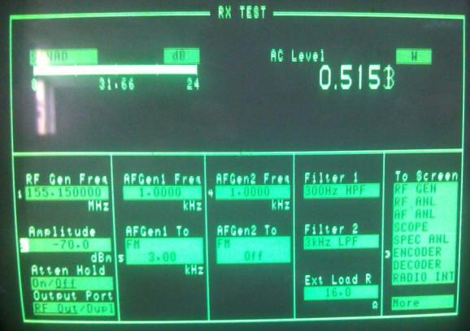
4
Test the parameter
Test RSSI
HP8921： Rx Test.
Set the value of Amplitude to-107dBm,. View the RSSI Icon on the radio, it should have one bar. Set the value of Amplitude to -70dBm. Wiew the RSSI Icon on the radio, it should have four bars.
RF Gen Freq: Rx frequency of radio
Input -107dBm | One bar
Input -70dBm | Four bars
Wide band:3kHz
Narrow band: 1.5kHz

Slide 26
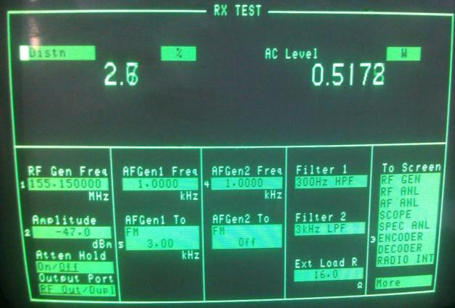
4
Test the parameter
RX Distortion
HP8921： Rx Test
Adjust the volume knob and adjust the volume to half of Maximum.(0.5w)
Set HP8921 to Distn. （Refer to the picture）
View the Distn value on the HP8921. It should be less than3%
Use the same way to test other frequencies
RF Gen Freq: RX frequency of the radio
Amplitude: -47dBm
Wide band:3kHz
Narrow band:1.5kHz
Filter 1:300Hz HPF
Filter 2: 3KHz LPF
Tx Distortion | ＜3%

Slide 27
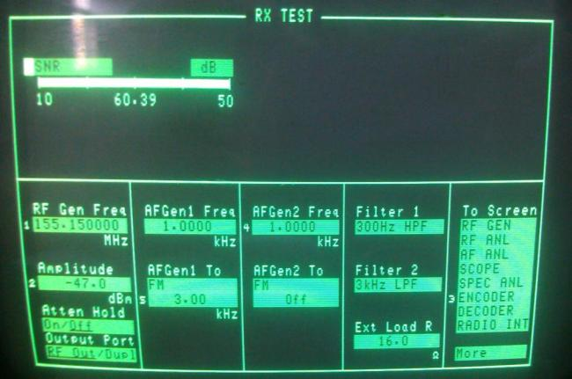
4
Test the parameter
RX S/N
HP8921： Rx Test
Adjust the volume knob and adjust the volume to half of Maximum.(0.5w)
Set HP8921 to SNR. （Refer to the picture）
View the SNR value on the HP8921. Refer to normal parameter in following form.
Use the same way to test other frequencies.
RF Gen Freq:RX Frequency of radio
Amplitude:-80dBm
Wide band:3kHz
Narrow band: 1.5kHz
Filter 1:300Hz HPF
Filter 2: 3KHz LPF
SN(Wide) | ＞45dB
SN(Narrow) | ＞35dB。

Slide 28
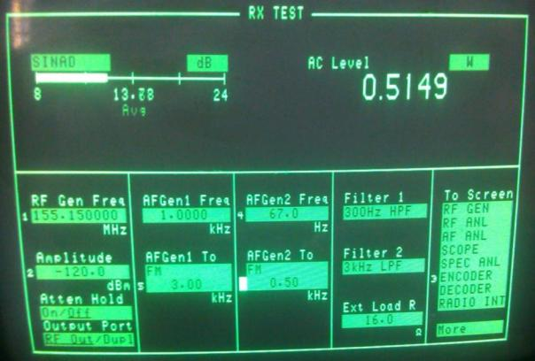
4
Test the parameter
Test the decode of CTCSS
HP8921:RX
Switch the channel to CTC/DSC channel
Open AF Gen2 and set its frequency to the matched frequency of the radio ctc. Set the value of AFGen2 to 0.5 for Wide band and 0.35 for narrow band. The radio will unmute.
Turn off the AFGen2, the radio will mute.
Use the same way to test other frequency.
设置为CTCSS频率
RF Gen Freq: Your radio RX frequency
Amplitude:-120dBm
Wide band:3kHz
Narrow band: 1.5kHz
Wide band: 0.5kHz
Narrow band:0.35kHz

Slide 29
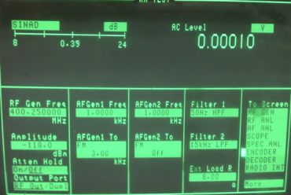
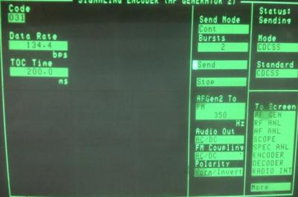
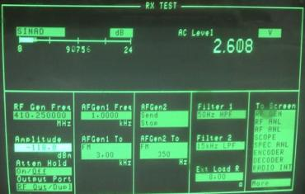
4
Test the parameter
CDCSS decode
Set the mode to CDCSS
RF Gen Freq :your radio rx frequency
Set to cont
Enter to encode mdoe
CDCSS\
Set to
HP8921： Rx Test.
Enter to encode interface.
3.Select send , the radio will unmute. When select stop the radio will mute.
Wide band:3kHz
Narrow band 1.5kHz
Wide band 0.75kHz
Narrow band: 0.35kHz

Slide 30
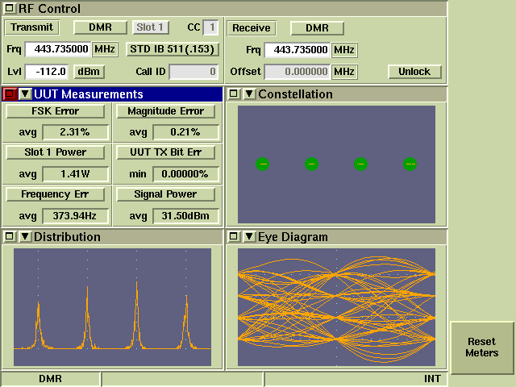
4
Test the parameter
TX 4FSK error、TX EVM error、TX BER
In the tune mode, you can find the 4FSK error, please enter to it
Set the 3920 to DMR test mode.
Set the receiver frequency to your radio TX frequency.
Press PTT to transmit, and view the FSK error and EVM on the 3920.
Use the same way to test other frequency.
TX 4FSK Error | ≤5%
EVM Error | ≤1%
TX BER | 0%

Slide 31
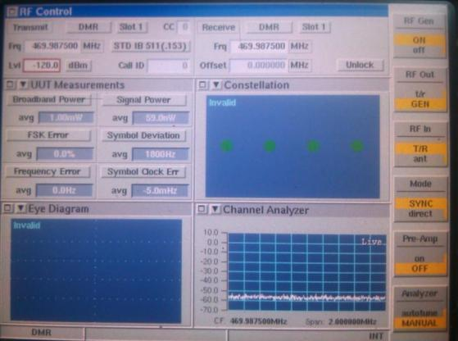
4
Test the parameter
RX BER
Enter to test mode in programming software
Set the 3920 to DMR test mode，Set theTransmit to the frequency of your radio tx. Out the standard signal(0.153,std 511)
Adjust the value of LV1，and view the BER on the radio. Stop to adjust this value until the the BER is 5%. Record the LV1 on the 3920.
Use the same way to test other frequency.
≤-120dBm时 | BER<5%

Slide 32
Tks!

